Slide 1
XML Introduction

Slide 2
Topics
How XML relates to other computer languages
The evolution of text markup technologies, including XML and its predecessors
To identify the basic features of XML

Slide 3
XML Defined
Extensible Markup Language
Both a Markup Language and Meta-language:
Markup Language
Design ways to describe information for storage, transmission, or processing by a program
Meta-language
Create a formal description of another language

Slide 4
XML as a Meta-language
Used to create XML-based Languages
Used to create specific documents or files unique to the developer, organization, or industry
The markup can be used to describe other languages
Allows the user to create their own XML tags

Slide 5
Meta-language Vocabularies
SGML
HARMONY
HTF
HTML
XML
WSDL
XAML
RSS
SCORM
TEI
CML
XHTML
MathML
CAPS
SMIL
MusicML
KML
Notes:
Point out XHTML, XAML, WSDL and RSS (also web.xml)
Office stored as XML (kind of)
SMIL – multimedia, CML – chemical
SCORM - Sharable Content Object Reference Model
WAP and WML – handheld devices
MSN Chat History - XML

Slide 6
XML as a Markup Language
Markup language is a set of commands that
tells a program how to display content.
defines the content or data
or describes a document’s logical structure.
Markup indicators are tags.

Slide 7
Evolution of XML
XML is designed :
As a document encoding language
To facilitate the creation of any number of additional markup/metalanguages
Languages can then be tailored to specific requirements of any organization or industry
Creates machine readable documents related to those languages
Notes:
Accepted by the W3C on February 10, 1998
Designed
With the simplicity of HTML
Developed as a public format
XML 1.0 (second edition) accepted by the W3C on October 6, 2000

Slide 8
What is XML?
An application profile
It is easier to define XML related languages for a specific organization or industry.
Designed to create specific document types for XML related languages and develop applications to handle those documents
The tagged data can be used for creation, management, and maintenance of large collections of complex information
Notes:
Why?

Slide 9
What is XML?
Platform independent
Software independent
Vendor- and technology-independent meta-language
Designed to deliver structured content over the Web
Notes:
Why is this important?

Slide 10
XML is not HTML
XML goal:
Designed to describe data and to focus on what the data actually is
Created to share richly structured electronic documents over the World Wide Web
HTML goal:
Designed to display the content and to focus on how the content looks

Slide 11
XML is Not HTML
The Future of XML and HTML
XML is used to structure and describe the Web data
Provides a facility to define tags and the structural relationship between them
HTML will be used to display and format data
XML will not replace HTML but coexist and complement HTML in many environments

Slide 12
HTML and XML Compared
HTML
Finite number of tags with predefined semantics
Used to display and format data
HTML features may not be supported by the latest releases of the various web browsers
With HTML do not need to follow strict XML requirements
Closing tags, closing stand alone tags

Slide 13
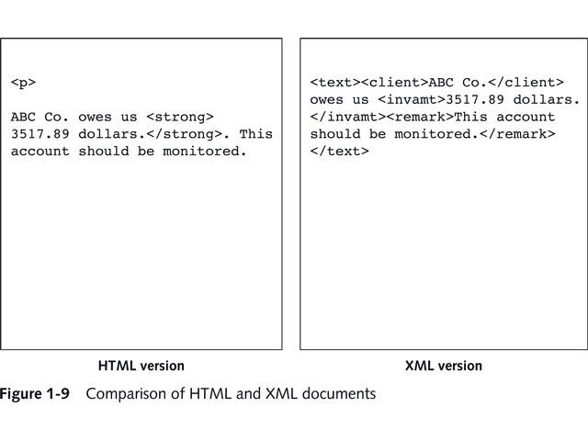
Comparing XML & HTML

Slide 14
Why is XML So Important?
Used in business by companies that share high volumes of information
Languages and standards easy to use:
Hundreds of XML-bases languages have been developed in recent years
Sharing data becomes fast and easy

Slide 15
Why is XML So Important?
XML removed a constraint from HTML
Dependence on inflexible document markup language (HTML) with predefined tags and semantics.
Does not provide for arbitrary structure or tags

Slide 16
When should XML be used?
XML tagged-data can provide high-precision searching in Web environments.
To allow users to interchange data over the Internet and through intranets
XML has an arbitrary structure and provides the ability to develop specific and unique tags.
XML allows development of user defined document types on the Web and is simpler to use.

Slide 17
XML Vocabularies
Defined:
Used to describe other XML-based markup languages
User can create their own sets of unique markup tags for their individual organization or industry
Ability to develop specific Document Type Definitions (DTD - outdated) or XML schema that work with XML documents

Slide 18
XML Vocabularies
Commonalities
Each vocabulary is written using the same XML standards and rules
Each vocabulary represents a markup language designed to describe content specific to an organization or industry

Slide 19
XML Weaknesses
XML may not meet all the specific organizational or industrial needs.
XML has a structured syntax.
Development of XML documents and markup languages requires more careful planning, because they are reusable.

Slide 20
World Wide Web Consortium and XML
W3C Recommendations
XML shall easily be implemented over the Internet
XML shall support a wide variety of applications
XML documents shall be legible to humans.
XML document design should be prepared quickly
XML document design shall be formal and concise.
XML documents shall be easy to create.
XML markup is not required to be terse.

Slide 21
10 Commandments of XML Design
XML must be easily usable over the Internet
XML must support a wide variety of applications
XML must be compatible with SGML
It must be easy to write programs that process XML documents
The number of optional features in XML must be kept to a minimum, ideally zero

Slide 22
10 Commandments of XML Design
XML documents should be clear and easily understood by nonprogrammers
The XML design should be prepared quickly
The design of XML must be exact and concise
XML documents must be easy to create
Terseness in XML markup is of minimum importance
Notes:
Class activity: whiteboard as teams
Define a table (i.e. top 3 movies, games, computers I have owned). > 2 rows, > 2 columns
Fill in the table with data
Encode as an XML document
Evaluate: well formed, human-readable

